Slide 1

Recommender Systems for Higher Education
Author: Hussain Abbas, MSc
© 2021 Stats AI LLC
All Rights Reserved

Slide 2
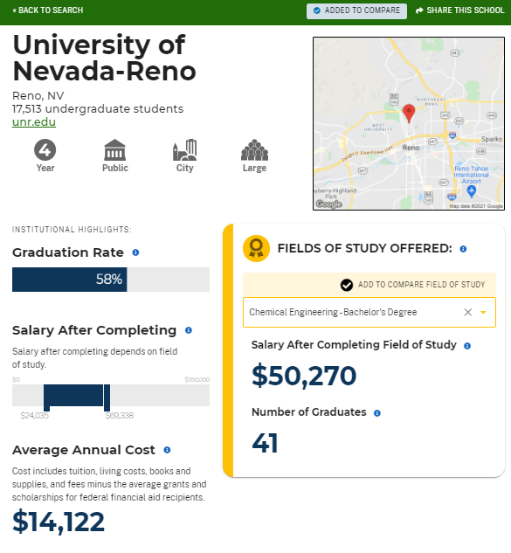
The College Scorecard
“Graduation Rate” and “Salary after Completing” are at the Institution Level, not at the Program level
Some programs don’t have salary data due to small sample sizes

Slide 3
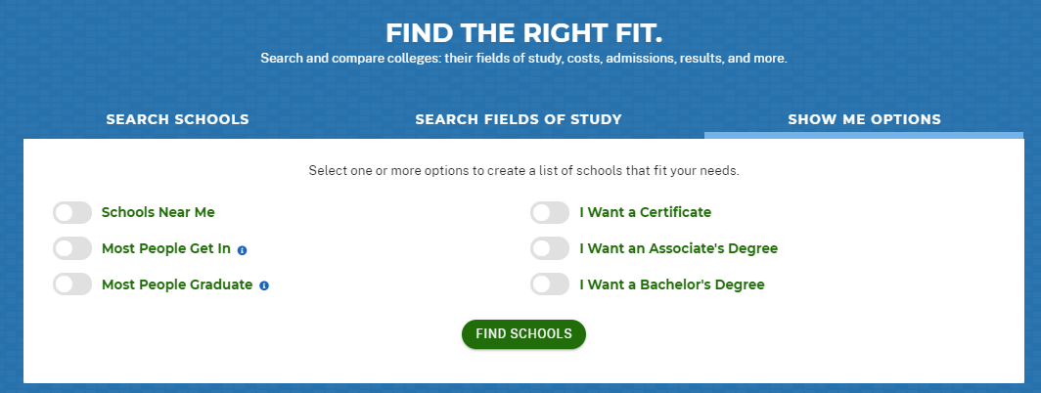
And to get there we have to “search” for it …

Slide 4
Does Netflix make you search for movies?
Does Youtube make you search for videos?
While both provide search, the value add is in …

Slide 5
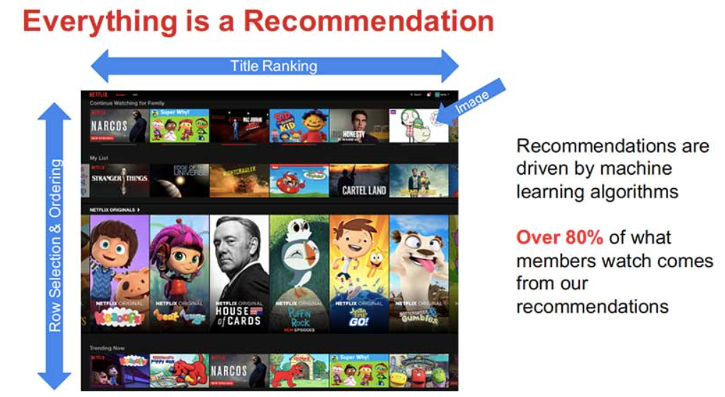

Recommender Systems!

Slide 6
Motivation
Users have a finite amount of time to spend on your website
Instead of spending time searching for content, users should spend that time consuming the content
Thus, RS enable users to skip the search process and jump straight to the content

Slide 7
So why is this still a thing? 😂😂😂

Slide 8
Benefits of framing the problem as a RS Task
We don’t have to worry about finding the best metric that values a given program
Instead, the user tells us what’s important to them
Or we just grab it from their Facebook profile …
The best RS is the one that users engage with the most

Slide 9
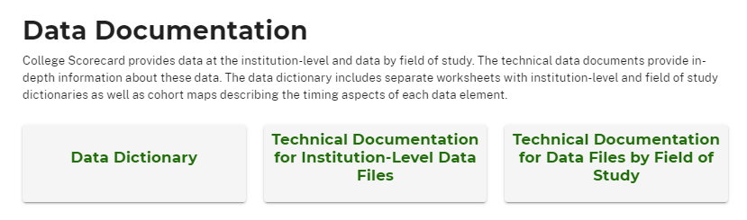
The College Scorecard website only shows a snippet of the available data!
Source: https://collegescorecard.ed.gov/data/documentation/

Slide 10
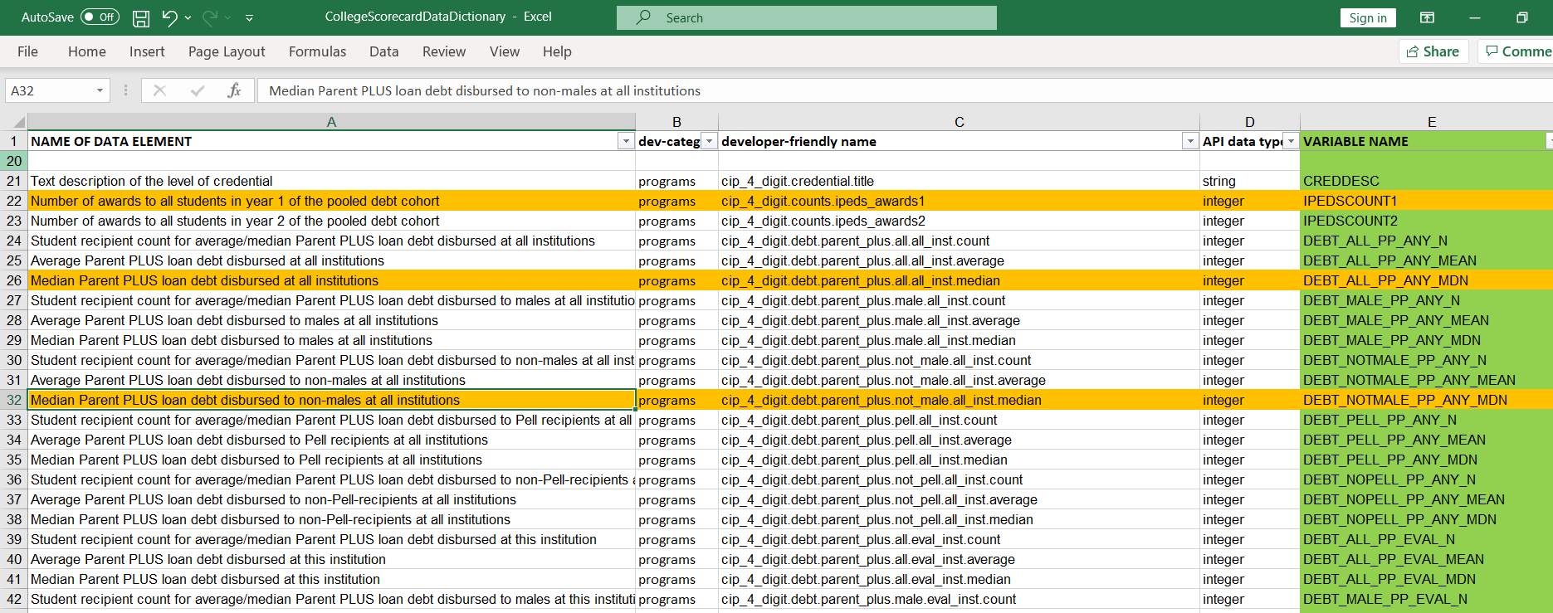

Slide 11
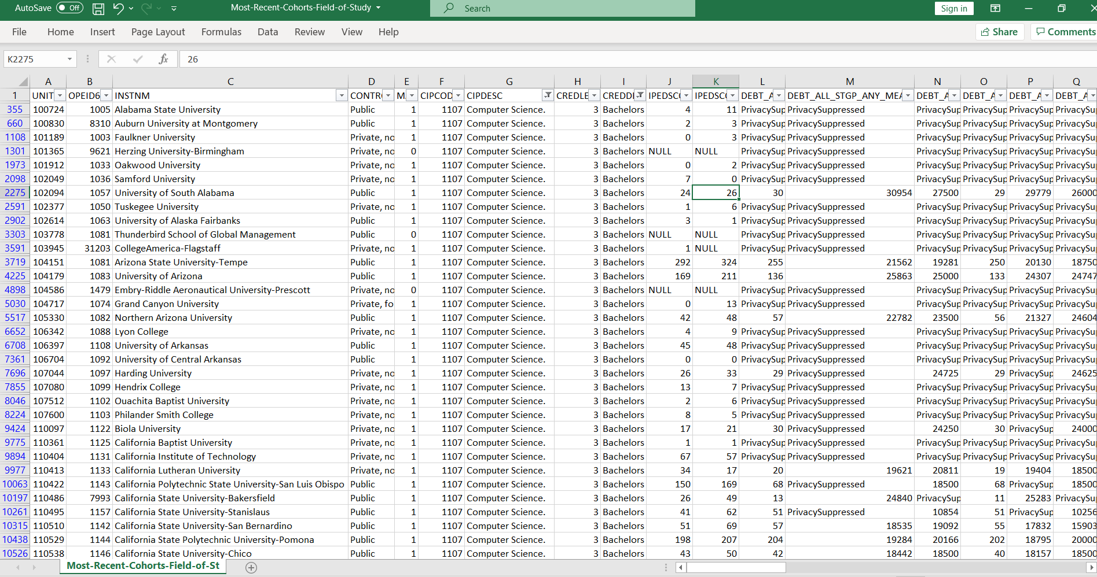
What does PrivacySuppressed mean?
Why are there so many of them?
Some variables are 100% “PrivacySuppressed”!

Slide 12
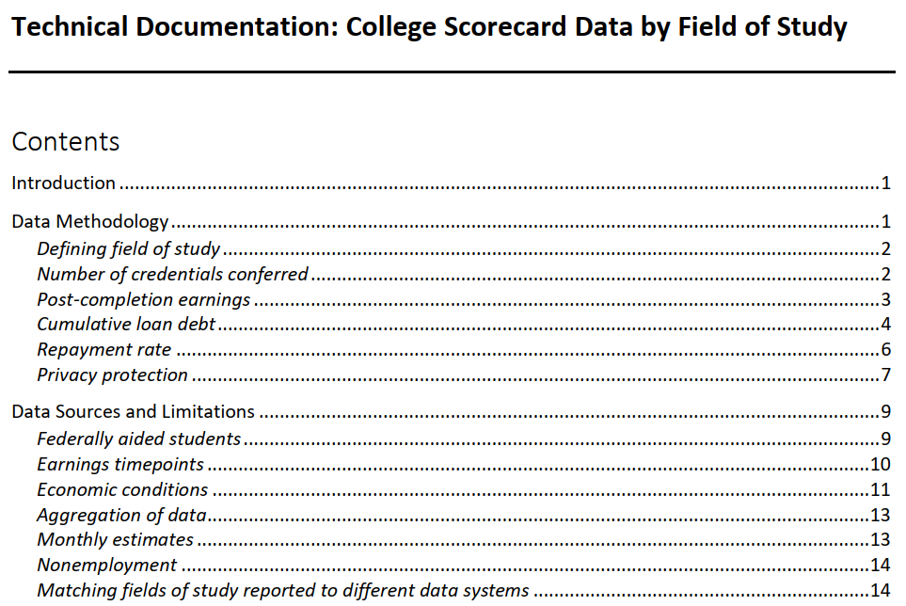
The College Scorecard only shows a snippet of the available data!
Enables us to understand what “PrivacySuppressed” means
Enables us to understand the data generating process

Slide 13
Conclusion
We can combine the data provided by the College Scorecard with data from users Facebook/Gmail profiles with their tastes and preferences to provide recommendations for programs of study
The best RS is the one that drives the most user engagement
We will still provide search capabilities, but the primary set of recommendations ought to come from the RS (just like Netflix)
The MVP we develop is an iterable that improves with time:
The more users engage, the more data we collect
The more data we collect, the better the recommendations
The better the recommendations, the more users engage 😎

